Slide 1

Sentiment Analysis ( Analyse the review or the text and provide the sentiment as whether it is positive or negative) Team2: Sheryl AG Niranjani T Mugil M R Jayarhupika

Slide 2
AGENDA
Web Scraping
Data preprocessing(Model used:Word2Vec,Fasttext,GloVe)
Feature engineering
Model training
What is the class of the problem(2 class-binary or multi class problem)
Is the data set balanced or unbalanced?
What data should be retained and which shall not be retained?
Most suitable evaluation metric for the problem

Slide 3
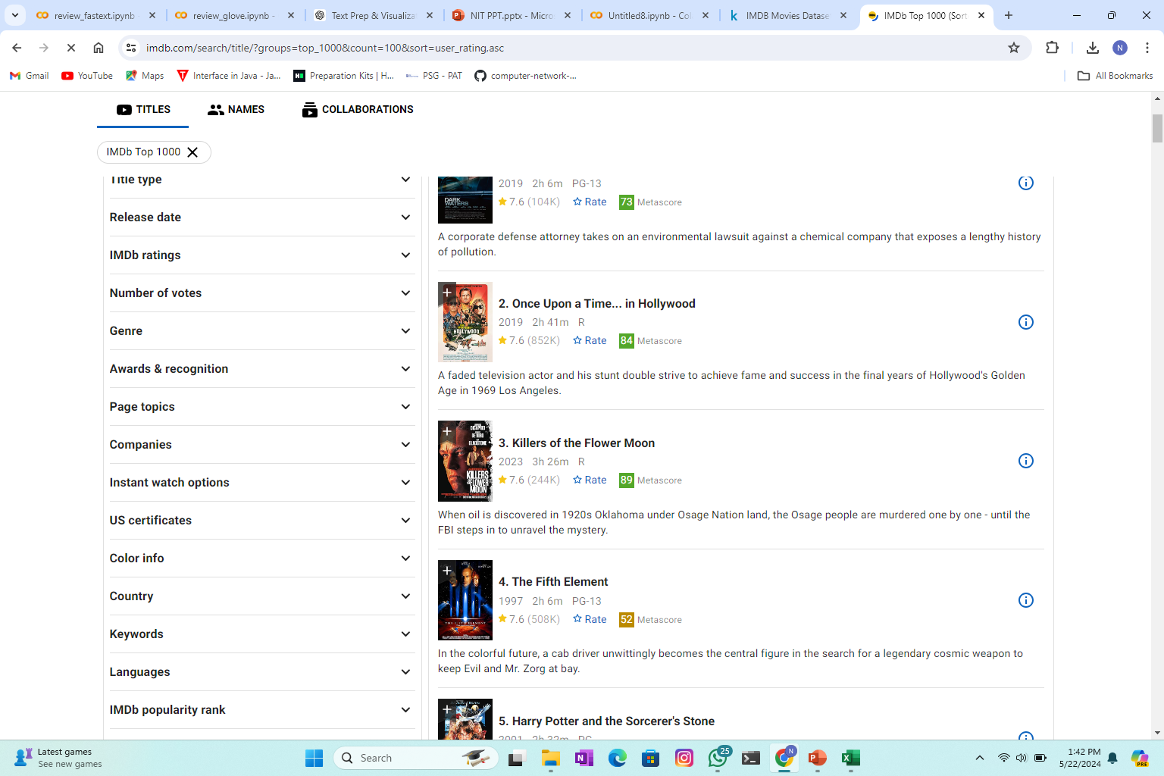
WEBSCRAPING
: Web Scraping IMDb Top 1000 Movies
Objective:
Extract details of the top 1000 movies from IMDb.
Save the data into a CSV file for further analysis.
Tools and Libraries:
BeautifulSoup: For parsing HTML content and extracting data.
Requests: For making HTTP requests to fetch web pages.
CSV: For writing the extracted data into a CSV file.

Slide 4
WEBSCRAPING
Fetching the Web Page:
Send a GET request to IMDb with appropriate headers to mimic a browser request.
Parsing and Extracting Data:
Use BeautifulSoup to parse the HTML content.
Identify the container elements for each movie using appropriate classes.
Writing Data to CSV:
Create and open a CSV file in write mode.
Write the header row followed by each movie's details.
Extract and clean specific details (rank, name, year, rating) for each movie.
Output:
A CSV file named imdb_top_1000.csv containing the extracted movie details.

Slide 5
WORD2VEC
What is Word2Vec?
Word2Vec is a popular technique used for natural language processing (NLP) tasks, developed by researchers at Google. It transforms words into continuous vector representations in a multi-dimensional space.
Applications of Word2VecSentiment Analysis:
Used to convert text data into numerical features for sentiment classification tasks.
Information Retrieval: Enhances search engines by understanding the semantic meaning of queries and documents.
Machine Translation: Improves the quality of translations by capturing the contextual meaning of words.
Recommendation Systems: Helps in understanding user preferences by analyzing textual data.

Slide 6
WORD2VEC
Title: Sentiment Analysis on IMDB Reviews Using Word2Vec
Subtitle: Analyzing Movie Reviews for Positive and Negative Sentiments
Data Preparation
Dataset: IMDB movie reviews dataset.
Initial Exploration: Checking for missing values and displaying the first few rows.
Cleaning Process:
Remove HTML tags.
Remove special characters.
Convert text to lowercase.
Tokenize the reviews.

Slide 7
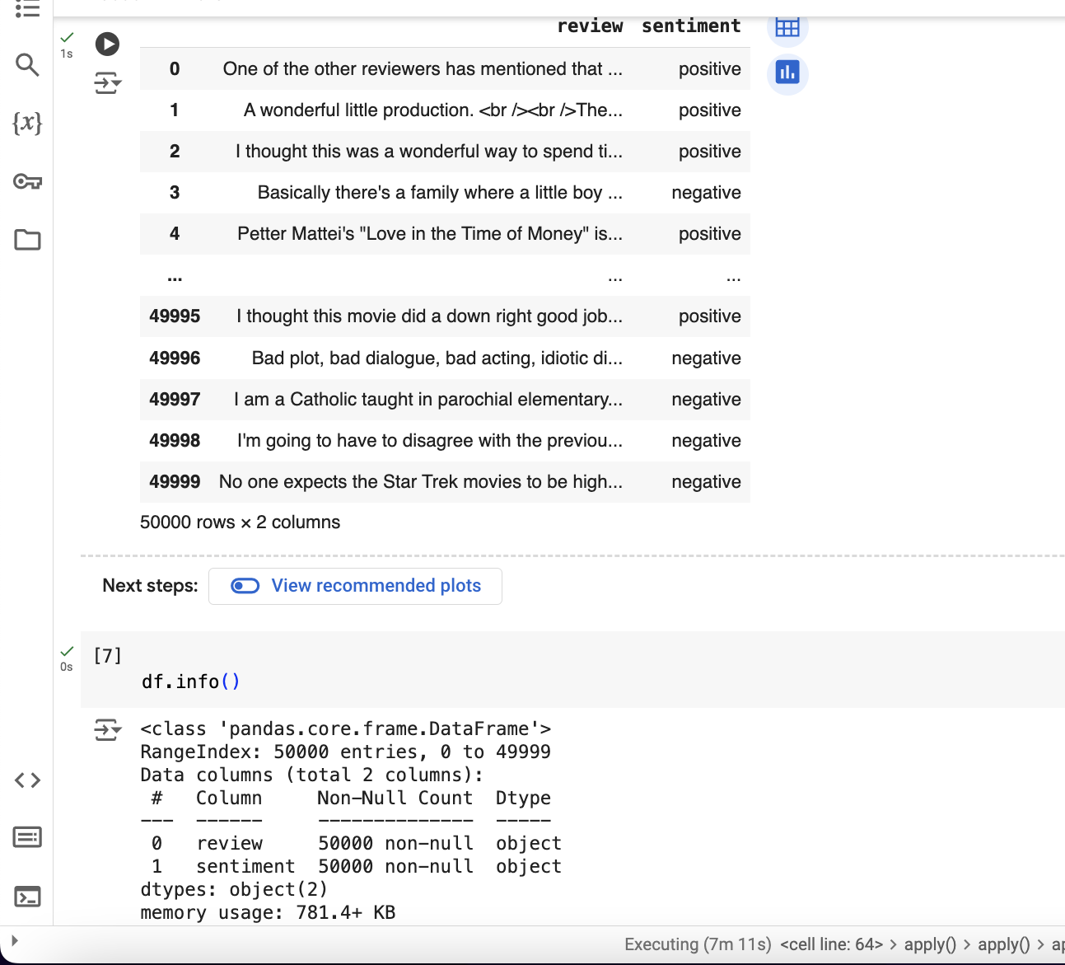
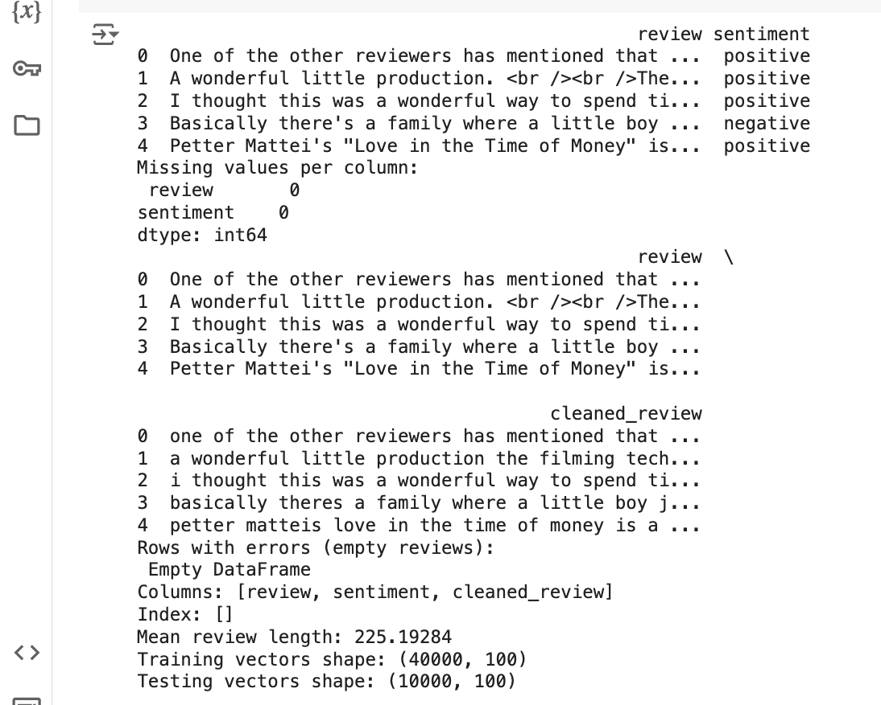

Slide 8
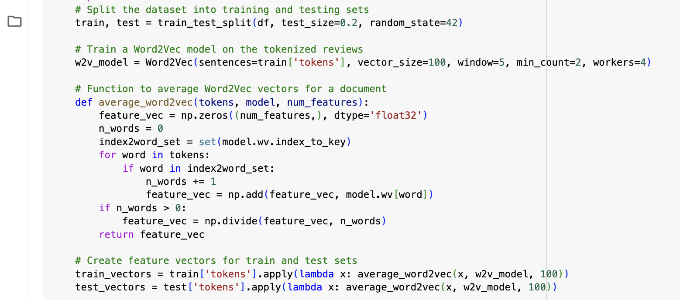
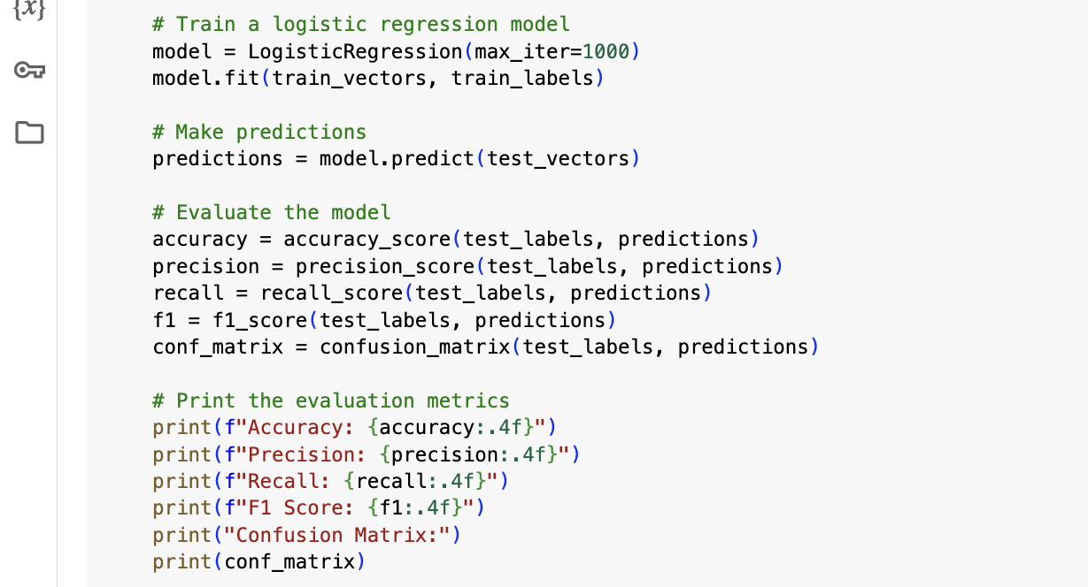

Slide 9
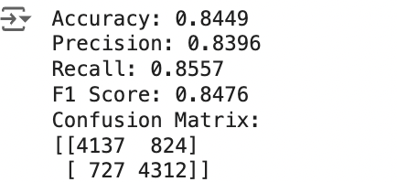
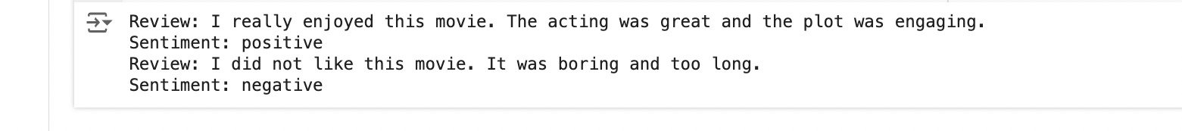
Evaluation metrics found
Custom input:

Slide 10
WORD2VEC
Data Cleaning and Tokenization
Cleaned Data: Example of raw vs. cleaned review.
Tokenization: Splitting cleaned text into individual words.
Issues Handled: Removing empty reviews post-cleaning.
Exploratory Data Analysis
Review Length: Mean length of reviews.
Distribution Plots:
Length of reviews.
Sentiment labels (to check for balance).

Slide 11
WORD2VEC
Word2Vec Model
Training: Training the Word2Vec model on tokenized reviews.
Parameters:
Vector size: 100
Window size: 5
Feature Extraction
Vectorization: Converting reviews to vectors by averaging Word2Vec embeddings.
Implementation: Using a custom function to create feature vectors from tokens.

Slide 12
WORD2VEC
Model Training
Model: Logistic Regression for binary classification.
Training and Testing Split: 80% training, 20% testing.
Encoded Labels: Positive = 1, Negative = 0.
Model Evaluation
Metrics Used:
Overfitting Check: Comparison of training and testing performance.

Slide 13
Fasttext:
What is FastText?
Library by Facebook’s AI Research (FAIR).
Efficient for word representations and text classification.
Why Use FastText?
Speed: Fast training and inference.
Versatility: Suitable for various NLP tasks.
Ease of Use: Simple and intuitive API.
Application on IMDb Dataset:
Goal: Classify movie reviews as positive or negative.
Steps:
Preprocessing: Clean and tokenize reviews.
Training: Train FastText model on processed data.
Evaluation: Test model performance on new data.

Slide 14
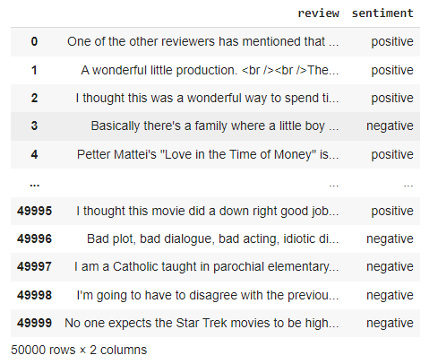
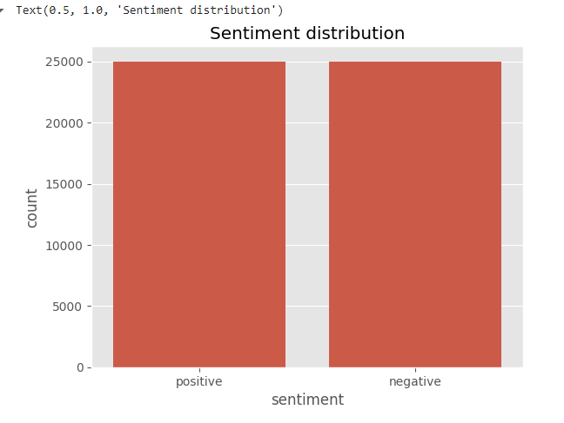
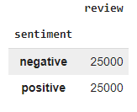
Introduction and Data Preparation
Overview:
Sentiment analysis using machine learning models
Dataset: IMDb movie reviews
Tools: NLTK, Pandas, Matplotlib, Plotly, FastText, TensorFlow
Data Loading and Exploration:
Load data using Pandas
Visualize sentiment distribution with Seaborn and Matplotlib

Slide 15
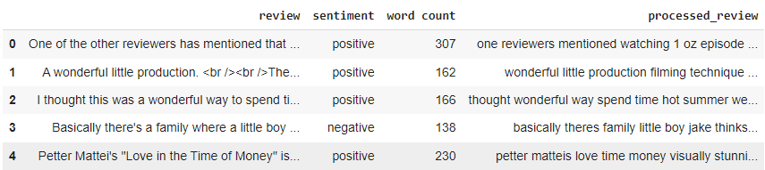
Text Preprocessing
Tokenization and Cleaning
Import necessary libraries: NLTK, Re
Remove HTML tags, URLs, and special characters
Convert text to lowercase and remove stopwords

Slide 16
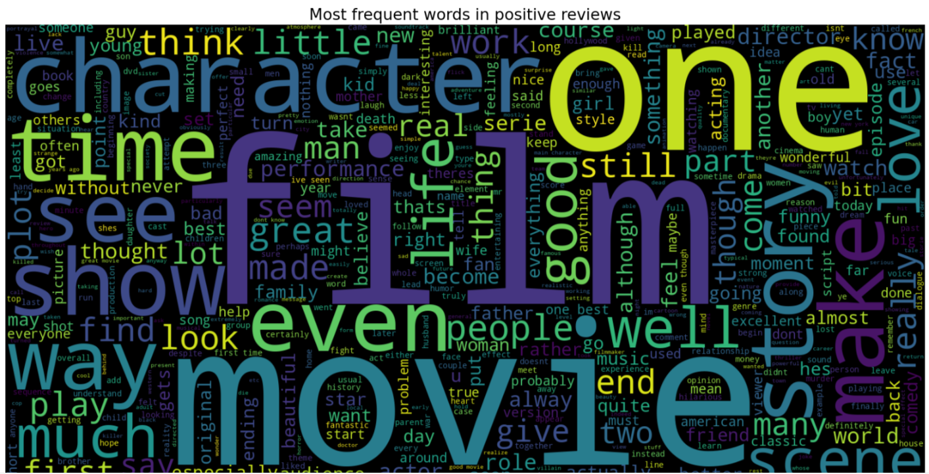
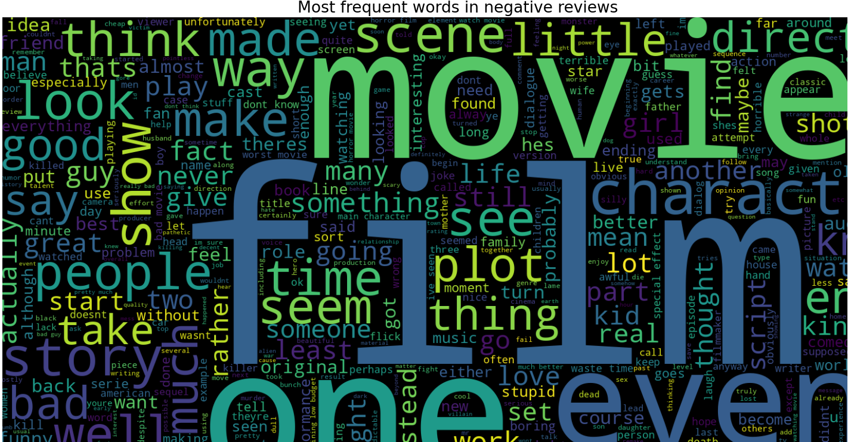
Word Count and Visualization
Word Count Calculation:
Calculate word count for each review
Word Cloud Visualization:
Generate word clouds for positive and negative reviews
Visualize most frequent words using Matplotlib

Slide 17
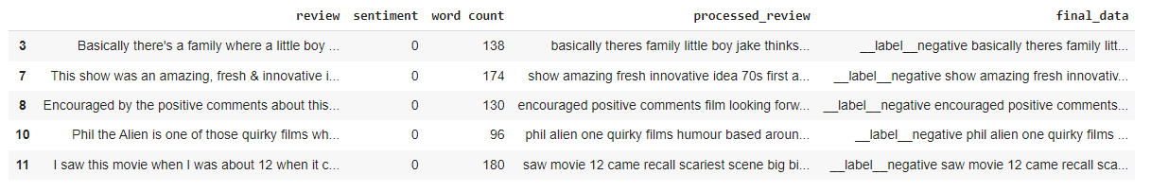
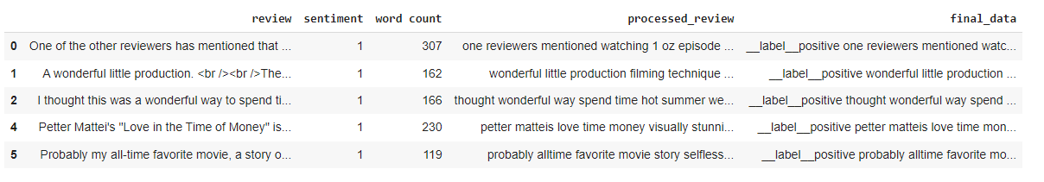
Predictions and Visualization
Model Predictions: Make predictions using the trained FastText model
Word Frequency Visualization:Plot common words in positive and negative reviews using Plotly

Slide 18
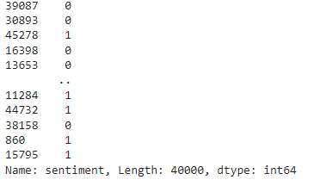
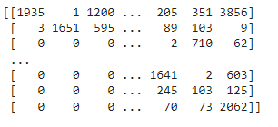
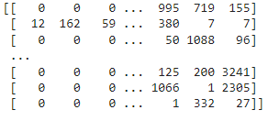
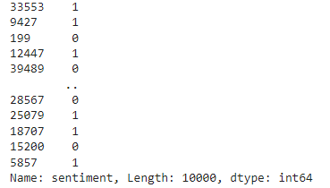
Data Splitting and Model Training
Data Splitting: Split data into training and testing sets
FastText Model Training:
Train FastText model on processed reviews
Evaluate model performance

Slide 19
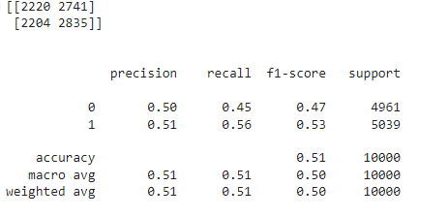
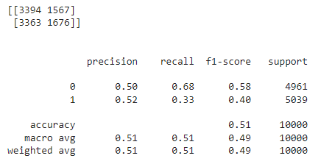
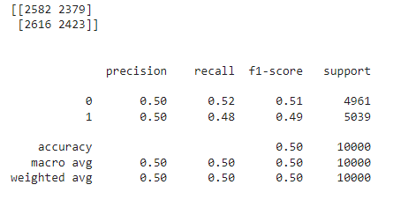
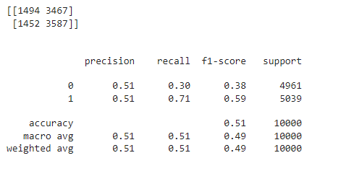
Model Training
Logistic regression andmultinomial naïve bayes
Linear svc

Slide 20
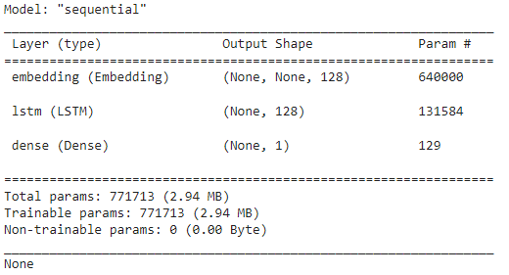
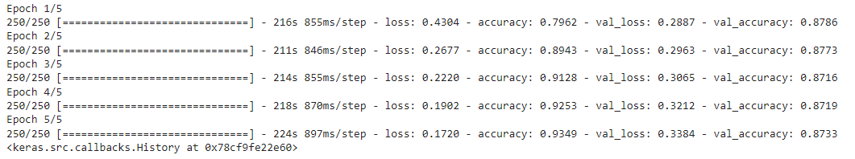
LSTM Model Implementation
Tokenization and Padding:
Tokenize and pad text data for LSTM model
LSTM Model Architecture:
Define and compile LSTM model using TensorFlow

Slide 21
Introduction to GloVe and Sentiment Analysis
What is GloVe?
Global Vectors for Word Representation (GloVe) is an unsupervised learning algorithm for obtaining vector representations for words.
Developed by Stanford NLP Group.
Captures the global statistical information of words in a corpus.
Objective:
Perform sentiment analysis on the IMDb movie reviews dataset.
Classify reviews as positive or negative using GloVe embeddings and a deep learning model.

Slide 22
Data Preparation and Preprocessing
Loading Data:
Read IMDb dataset containing movie reviews and sentiments.
Balance dataset: Convert sentiment labels to binary (positive=1, negative=0).
Download GloVe Embeddings:
Download and unzip GloVe pre-trained embeddings.
Load GloVe embeddings into a dictionary for easy access.
Tokenization and Lemmatization:
Use NLTK for tokenizing and lemmatizing text.
Remove unwanted tokens and keep only those present in GloVe embeddings.

Slide 23
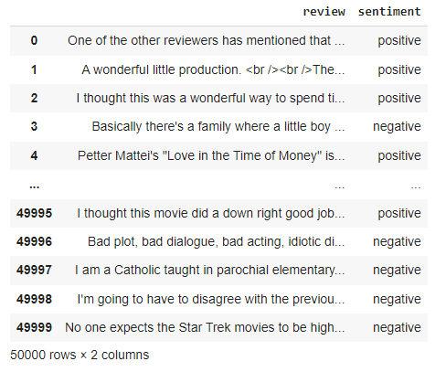
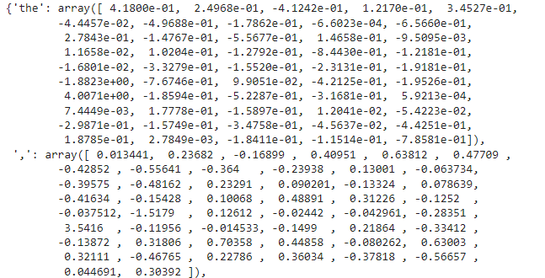
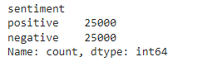
Data preprocessing

Slide 24
Converting Text to Word Vectors
Token to Vector Conversion:
Convert each token in a message to its corresponding GloVe vector.
Handle tokens not present in GloVe by skipping them.
Padding Sequences:
Ensure uniform sequence length by padding shorter sequences with zero vectors.
Typical sequence length chosen based on the dataset's distribution.
Data Splitting:
Split the dataset into training, validation, and test sets (70%-15%-15%).

Slide 25
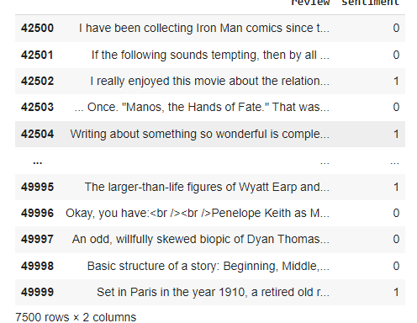
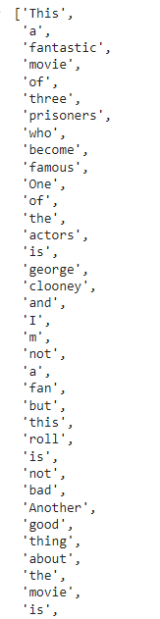
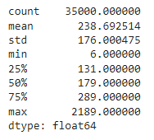
Data Preparation for Model Training
Convert DataFrame to Features and Labels:
Extract features (X) and labels (y) from the DataFrame.
Convert reviews to sequences of word vectors.
Padding and Sequencing:
Pad sequences to ensure uniform length across all samples.
Tokenizer:
Fit tokenizer on training data to convert text to sequences.
Apply padding to ensure uniform input size for the model.

Slide 26
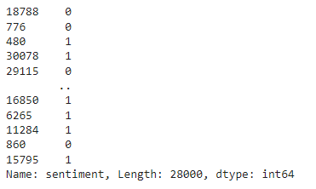
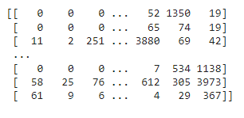
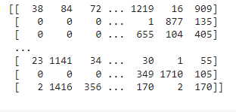
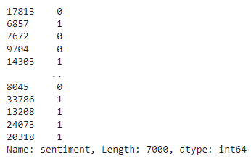
MODEL Training
X_train and test data
Y_train and test data

Slide 27
Building and Training the Model
Building and Training the LSTM Model
Model Architecture:
Sequential model with Embedding layer, LSTM layer, and Dense layer.
Embedding layer: Converts token indices to dense vectors of fixed size.
LSTM layer: Captures temporal dependencies in the text data.
Dense layer: Outputs a single prediction (positive or negative).
Model Compilation:
Optimizer: AdamLoss
Function: Binary Cross-Entropy
Metrics: Accuracy
Model Training:Train model with training data, validating on validation set.
Epochs: 5
Batch size: 128
Validation split: 20%

Slide 28
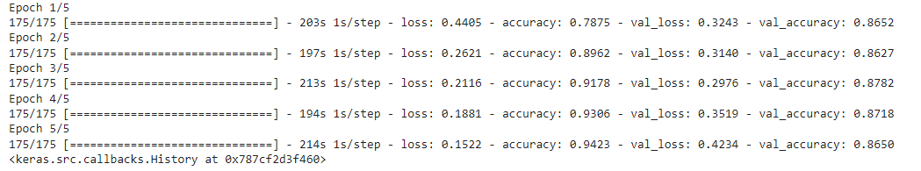
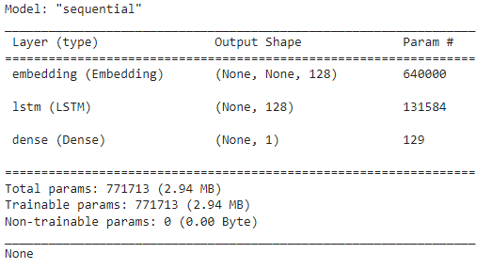

Slide 29
Evaluation and Results
Model Evaluation:
Evaluate the trained model on the test set to determine its performance.
Metrics: Accuracy on test data.
Performance Metrics:
Accuracy: Measures the proportion of correctly predicted reviews.
Conclusion:
GloVe embeddings combined with LSTM effectively capture sentiment in movie reviews.
Model can be further tuned for improved performance.

Slide 30
What is the class of the problem(2 class-binary or multi class problem)
Two-Class (Binary) Problem
Involves distinguishing between two distinct classes or categories. Each instance in the dataset is labeled with one of these two classes.
Multi-Class Problem
Involves distinguishing among three or more distinct classes or categories. Each instance in the dataset is labeled with one of these multiple classes.
Example1:Handwritten Digit Recognition: Classify images of digits (0-9).
Example2:Language Identification: Classify text as one of several languages (e.g., English, French, Spanish, etc.).
Output: The model outputs one of three or more possible classes
For our project on sentiment analysis,
All the texts and reviews are analysed and a sentiment based on 2 classes are classified as positive and negative. So by this, it can be clearly defined as a binary class problem.
Examples: Spam Detection Sentiment Analysis
Output: The model outputs one of two possible classes.

Slide 31
Is the data set balanced or unbalanced?
The IMDb dataset is typically considered to be balanced. This dataset consists of 50,000 movie reviews that are evenly split between two classes: positive and negative sentiment. Specifically, there are 25,000 positive reviews and 25,000 negative reviews.
Here are some details about the IMDb dataset:
1. Size: 50,000 movie reviews in total.
2. Classes: Two classes - positive sentiment and negative sentiment.
3. Distribution: 25,000 reviews for each class.

Slide 32
What data should be retained and which shall not be retained
Data to Retain
1. Text Content: The actual review text is the most crucial part of the dataset. This is the primary data used for training the sentiment analysis model.
2. Sentiment Labels: The labels indicating whether a review is positive or negative are essential for supervised learning.
3. Basic Punctuation: Retain punctuation that can influence sentiment, such as exclamation marks (!) and question marks (?), as they can provide context and convey strong emotions.
4. Negation Words: Words like "not", "never", "no" should be retained as they can flip the sentiment of a sentence.
5. Important Stop Words: Some stop words might be important for understanding the sentiment and context, so a careful selection of which to retain is beneficial

Slide 33
What data should be retained and which shall not be retained
Data to Discard
1. HTML Tags: Remove any HTML tags that might be present in the text, as they do not contribute to the sentiment analysis task.
2. Special Characters: Discard special characters (e.g., @, #, $, %, &, etc.) that do not contribute to the sentiment of the text unless they have specific relevance to your analysis.
3. Numbers: Numbers can often be removed unless they hold specific sentiment value (e.g., ratings within the review text).
4. Excessive Whitespace: Normalize whitespace to ensure consistent text formatting.
5. Common Stop Words: Depending on your approach, common stop words like "the", "is", "in", etc., can be removed to reduce noise in the data. However, some stop words might be retained if they help in context.

Slide 34
Most suitable evaluation metric for the problem
Accuracy:
Proportion of correctly predicted reviews.
Best for balanced datasets.
Precision & Recall:
Precision: True positives among predicted positives.
Recall: True positives among actual positives.
Important for imbalanced datasets.
F1-Score:
Harmonic mean of precision and recall.
Balances precision and recall, ideal for imbalanced datasets.
Conclusion:
Balanced datasets: Accuracy
Imbalanced datasets: F1-Score

Slide 35

Thank you

